Slide 1


Arduino-Based Multi-Sensor Hazard Monitoring and Early Warning Unit
Students:
1.Ankith Joshi [RVCE25BAS051]
1.Shreyas M [RVCE25BAS058]
1.Ramanujan A K [RVCE25BAS0]
1.Mithun V Y [RVCE25BAS0]
Mentor: Dr. Roopa
RV College of Engineering

Slide 2
Introduction
Disasters such as fire accidents, toxic gas leakage, flooding, and unexpected structural vibrations continue to pose major risks in both domestic and industrial environments. These hazards often occur without warning and can escalate rapidly, causing significant damage to property and endangering human life. In many houses, small scale industries,labs,workshops and storage units the safety systems are rather outdated or only designed to handle single type of hazards

Slide 3
Introduction[Motivation]
The increasing accessibility of embedded systems and open-source hardware has created new opportunities to develop affordable, multi-functional safety devices. Microcontrollers like Arduino allow seamless integration of various sensors, enabling real-time monitoring of environmental conditions. By combining multiple detection mechanisms into a single, unified system, it becomes possible to provide faster alerts and reduce dependency on multiple standalone devices.

Slide 4
Objectives
This project aims to design and implement an Arduino-based Multi-Hazard Early Warning and Alert System that can simultaneously detect fire, hazardous gases, rising water levels, and abnormal vibrations.
The system incorporates dedicated sensors for each hazard and provides instant alerts through visual indicators and audible alarms

Slide 5
Methodology
Water Level Detection
Water levels in the containment vessel were raised gradually. With each incremental rise of the water level, the sensor registered an increase in the sensor output, and the buzzer sounded an alarm when the threshold was exceeded. An SMS message was created.
Vibration Detection
To simulate the effects of minor vibrations the sensor was subjected to gentle tapping and gentle shakes. Each time a gentle tap/shake was applied to the sensor, it was easily detected as sudden movement by the vibration sensor. As a result, the Arduino was activated and generated an alert.
Humidity and Temperature Detection
The sensor was placed into a warmer area and subsequently into a cooler area. There were corresponding changes in temperature and humidity output from the sensor for each test.

Slide 6
Experimental Setup
The entire system was assembled on a wooden baseboard. In the experiments, the system’s sensors were arranged in a configuration similar to that of real life:
The water level sensor was positioned within a container of water simulating a rise in the water level of a flood.
The vibration sensor was placed on the tabletop so that controlled shaking could be applied.
The temperature/humidity sensor was placed indoors and outdoors to determine value variation.
The Arduino IDE was used on a laptop to retrieve the values of the sensors via Serial Monitor.

Slide 7
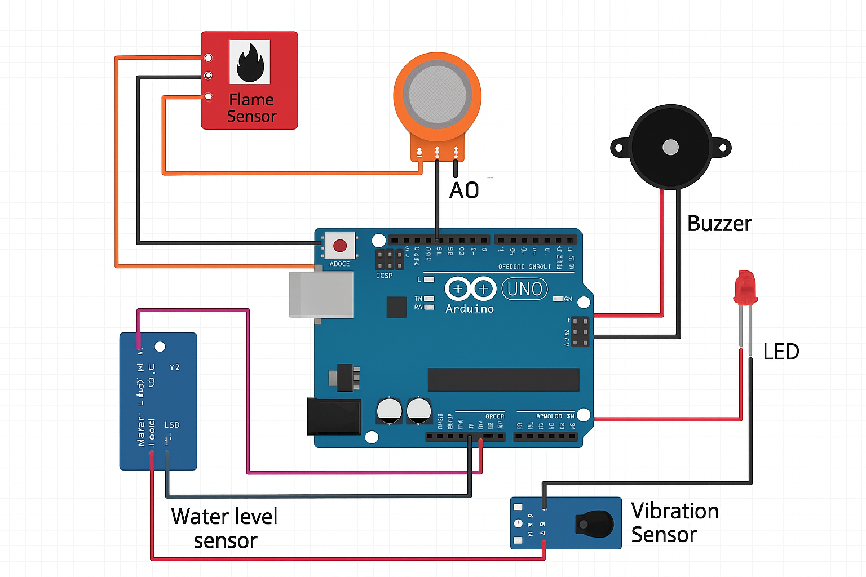
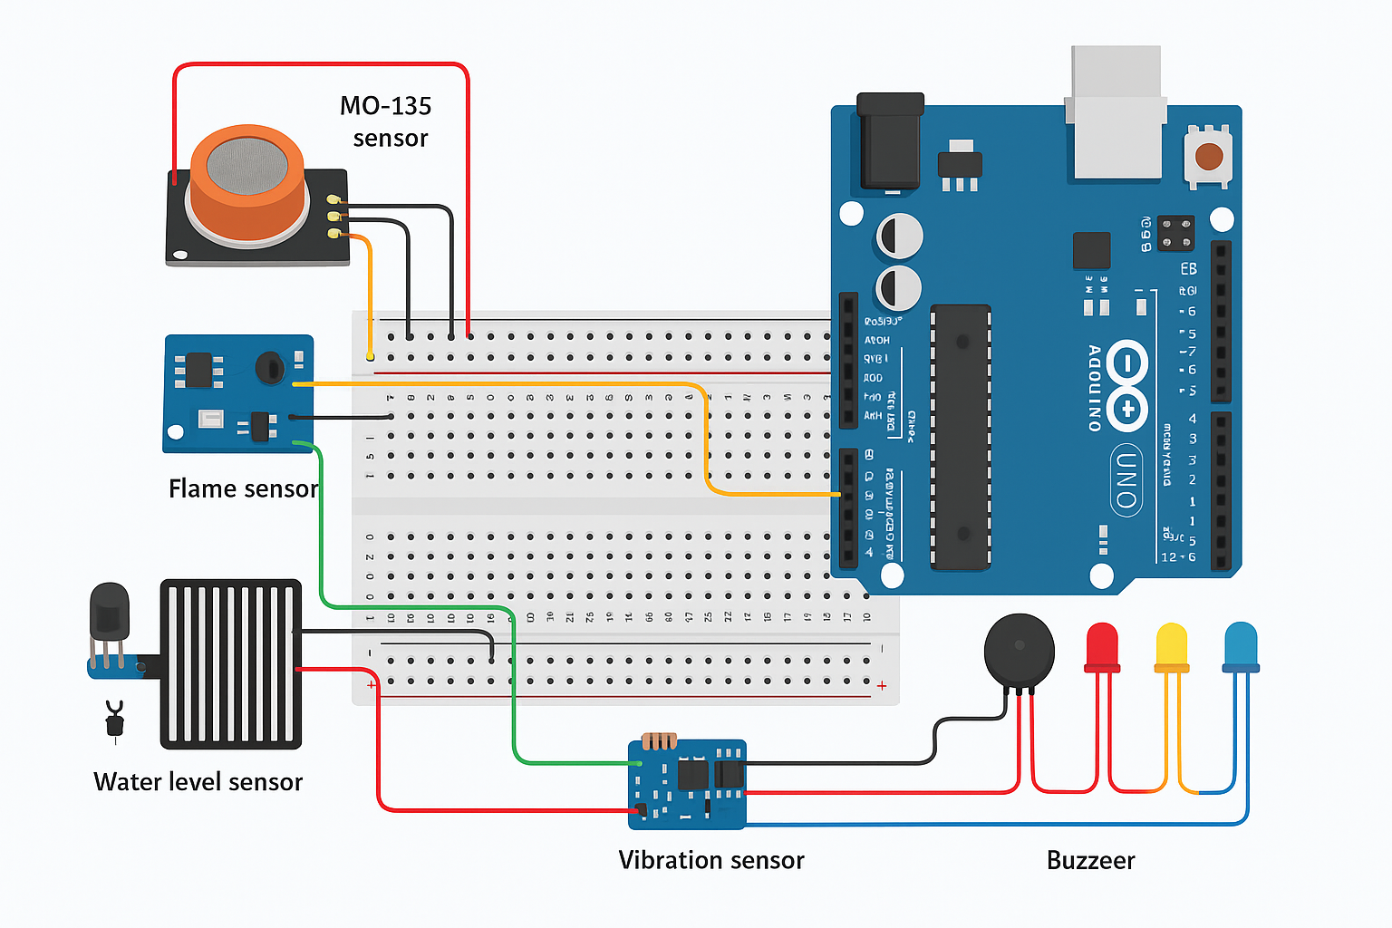
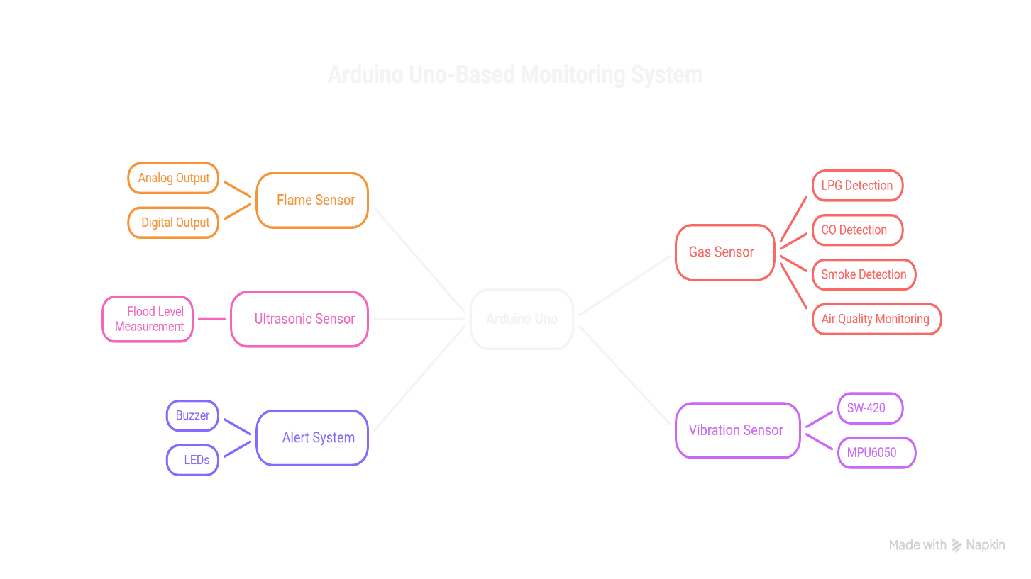
Circuit Diagram

Slide 8
Component List
Arduino UNO
Water Level Sensor
Vibration Sensor (SW-420)
Temperature & Humidity Sensor (DHT11/DHT22)
Buzzer and LED Indicators
Power Supply
A 9V battery or USB power is used to power Arduino and sensors.

Slide 9
Working Principle
Sensor Detection:
  Fire sensor detects flames or high temperature.
  Gas sensor continuously monitors air quality for harmful gases.
  Water-level sensor monitors flood risk.
  Vibration sensor detects abnormal structural movements.
Data Processing:
Arduino reads sensor data and compares it with predefined thresholds. Advanced designs may include ML models to detect anomalies and reduce false alarms.
Alert Generation:
  If a hazard is detected, the system activates local alarms (buzzer, LED).

Slide 10
Results & Discussion
Quantitative Results
Fire Sensor: The flame sensor registered the presence of an open flame within fractions of a second at close range.
Gas Sensor:MQ-135 outputs required the standard warm-up (stabilization) time; after warm-up the module detected concentration changes reliably
Water-level sensor: The water-level sensor worked as expected, When the water level rose above a certain pre-defined threshold limit, A alert was triggered to warn the rise in water-level
Vibration Sensor: SW-420 reliably toggled its digital output on light taps and stronger shakes.
ALERTING
The hazard detection system activated the specific LEDs and the Buzzer almost instantly for the flame and vibration sensor but was slightly delayed for the Gas and Water-level sensor based on speed on immersion

Slide 11
Conclusion
Arduino-based Multi-Hazard Early Warning System integrating flame, gas, water-level, and vibration detection. The prototype demonstrated reliable local alerting through This project successfully developed a low-cost LEDs and a buzzer
The unified approach reduces the need for multiple standalone detectors and provides a practical, extensible foundation for improved safety in households, small industries, and institutional environments

Slide 12
Future Prospects
IoT Integration: Use ESP32/Wi-Fi or LoRaWAN to send sensor telemetry to cloud dashboards and mobile apps for remote monitoring, historical logging, and analytics.
Machine Learning & Analytics: Apply edge or cloud-based ML to multi-sensor patterns for predictive alerts (reducing false positives) and anomaly detection
Hardware Robustness: Design a custom PCB, rugged connectors, and IP-rated enclosure for field deployment; include hardware watchdogs and RTC-backed logging.
Standards & Interoperability: Align with multi-hazard early warning frameworks and consider integration with municipal emergency services for automated escalation.

Slide 13
References
F. M. Mims, Electronic Sensor Circuits & Projects, Newnes, USA, 2007.
D. Patranabis, Sensors and Transducers, 2nd ed., PHI Learning, New Delhi, India, 2010.
R. K. Rajput, Sensors and Control Systems in Engineering, S. Chand & Company, New Delhi, India, 2014.
A. Sharma and R. Kumar, “Arduino-Based Fire Detection and Alarm System,” International Journal of Engineering Research & Technology (IJERT), vol. 8, no. 6, pp. 245–249, 2019.
R. Suresh and J. Thomas, “Arduino-Based Flood Monitoring and Alert System,” International Journal of Scientific Research in Engineering and Technology, vol. 10, no. 4, pp. 89–93, 2021.
Datasheets and manuals

